Slide 1
Using Bayesian Optimization in Pose Graphs Based SLAM 2nd June
Zuxun Wang

Slide 2
Progress Since Last Meeting
Characteristics of chi2 model
Linear model -> multiple omega, checking x
Static Model -> run multiple times, average chi2Store
Dynamic Model -> run multiple times, average chi2Store

Slide 3
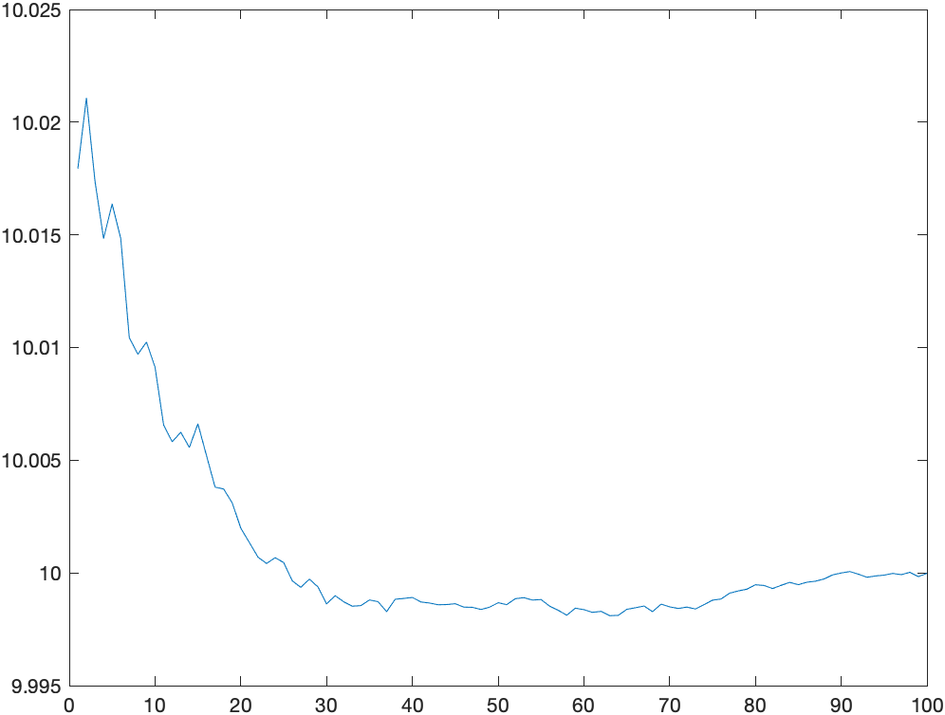
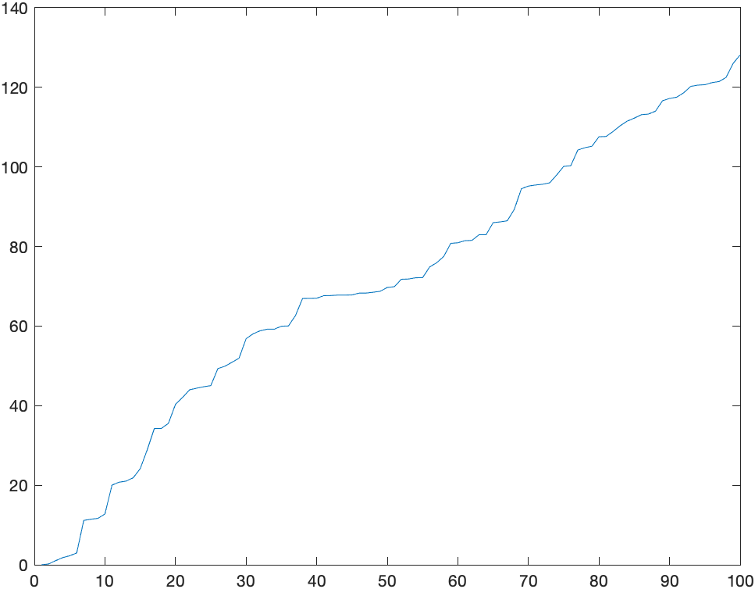
1D Static Model – Changing SigmaR to 0.0001
State
Chi2

Slide 4
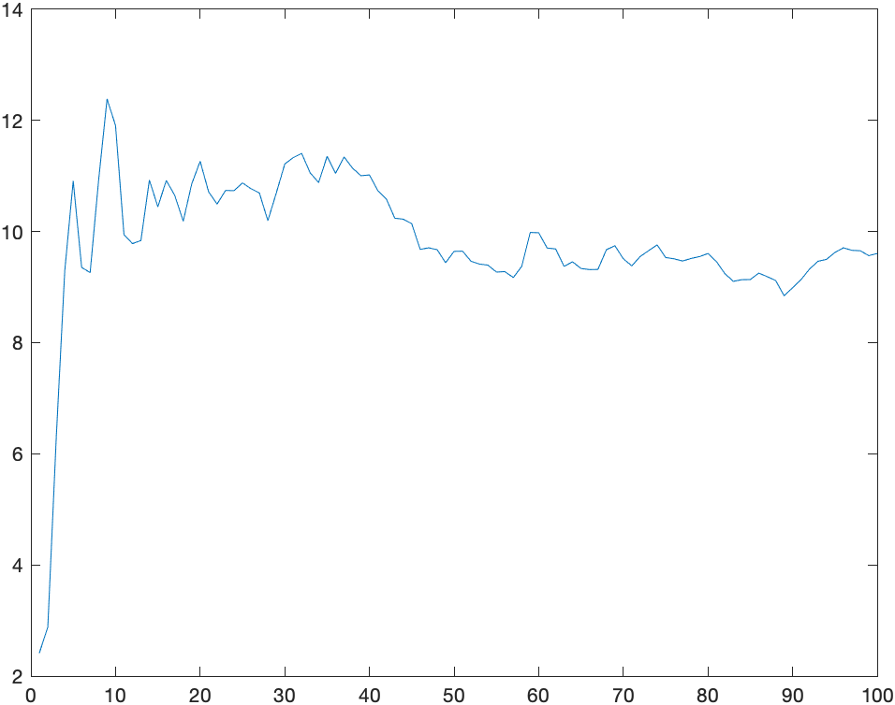
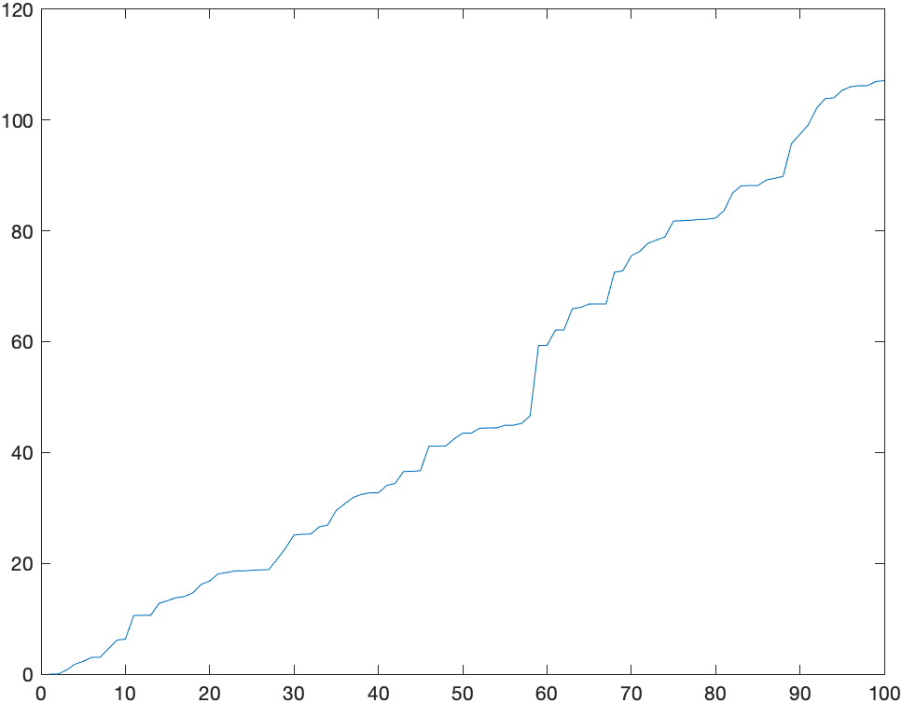
1D Static Model – Changing SigmaR to 100
State
Chi2

Slide 5
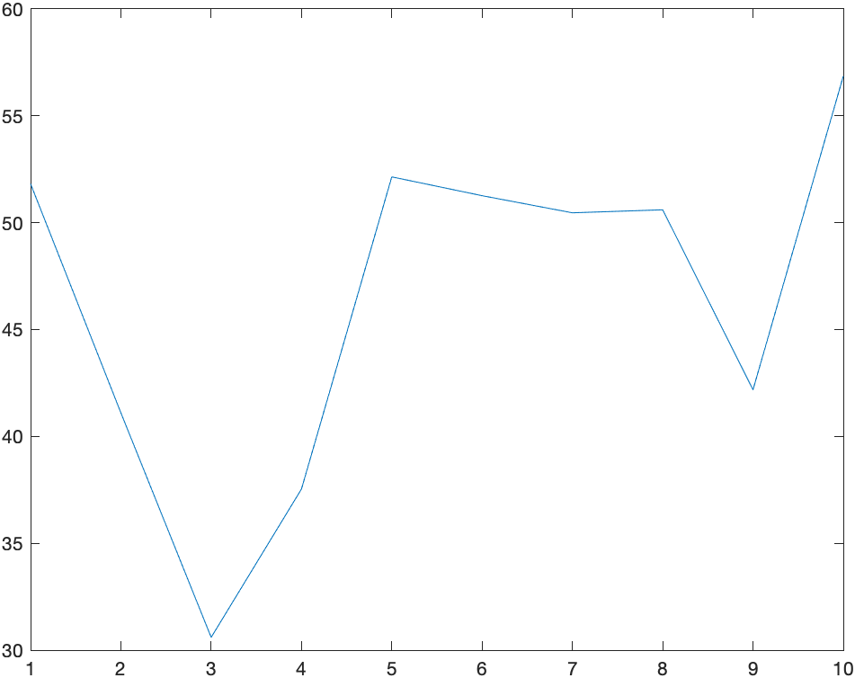
1D Static Model - Multiple Running Times
Keep SigmaR to be 1
Set the number of running times 10
Compute the average of chi2 value of optimised graph for each run
Mean of Chi2 for Each Run

Slide 6
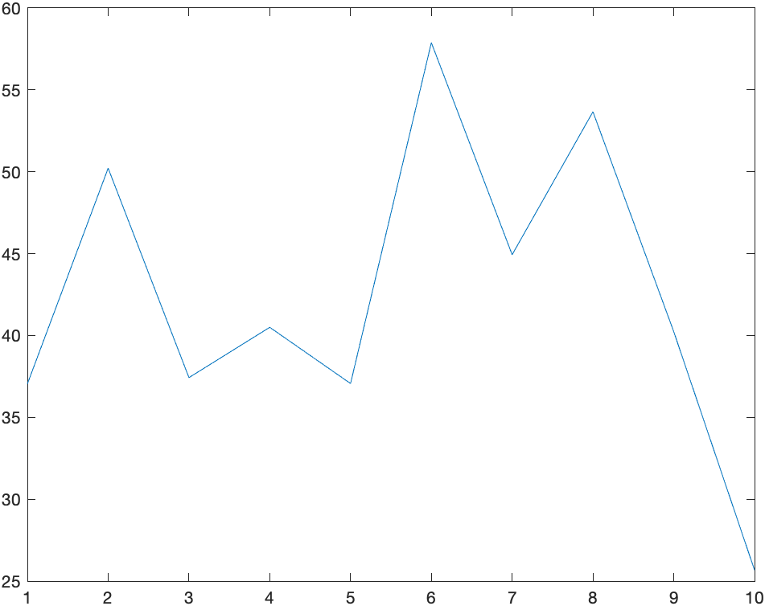
2D Dynamic Model - Multi Running
SigmaR = 1
SigmaQ = 100
Set the number of running times 10
Compute the average of chi2 value of optimised graph for each run
Mean of Chi2 for Each Run

Slide 7
Problems / Issues
In the 1D Static model, we average the chi2Store, which stores the accumulated chi2 value when constructing the graph.
In 2D Dynamic model, I compute the accumulate chi2 values manually since the graph is optimized only once at the end of each run.
My questions are:
1. Why should we use the accumulated chi2 to compute the mean? Why don’t we use the overall cost, i.e., the final chi2, instead?
2. The 2D model only optimize the graph at the end of graph construction, why couldn’t we optimize it on-the-fly like 1D static model?

Slide 8
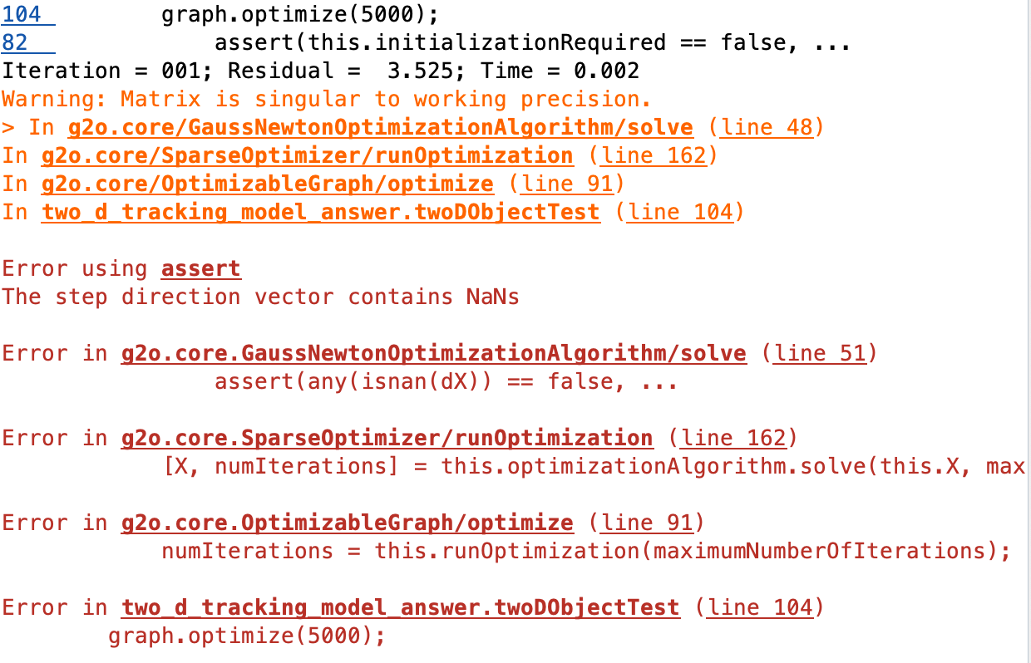

Slide 9
Planned Activities
Check cw2 task 3
gpsVehicleTracking and LandmarkVehicleTracking Examples
Double check chi2, use the final chi2 value of graph
(Code from Simon)

